Slide 1
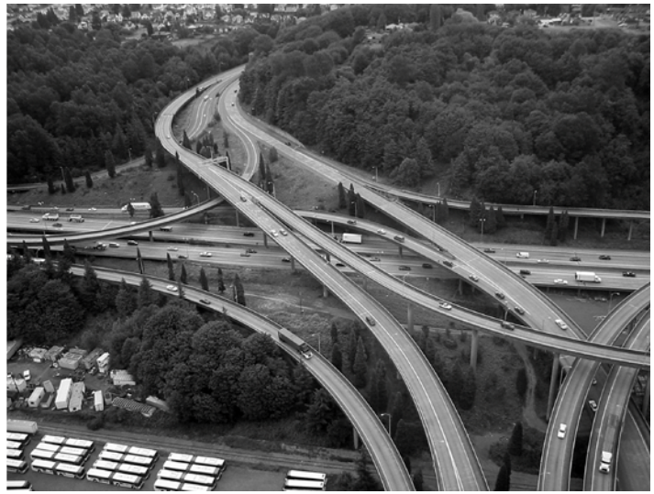
Planning
How to figure out what to do.

Slide 2
Development Release Planning
DR0
DR1
DR2
DR3
DR4
DR5
(TGA)
DR6
(ТC1)
TC2
Initial documents
development
Single concept
selection
Inner validation
and RFQ
Work of supplier
and OEM
Tooling
development
TechReq
First product
samples
production
Concept 1
Concept 1
Ipmlementation 1
Concept 2
Implementation 2
Concept 2
DR0 status:
- Empty docs for further fulfillment,
- Docs fromprevious project.
DR2 status:
only for single pack of documents,
which describes single concept
DR4 status:
only for 1 implementation,
which produced by suppliers
DR6 status:
only for docs, which ready for
mass production
Technical Conditions 2
DR1 status:
Every single set of docs describes 1 Concept and includes:
Technical Requirements (TR);
Validation Plan (VP);
3D;
2D (deprecated);
Technical Conditions (TC);
LOI;
FMEA;
...
DR3 status:
only for validated set of documents, which ready to transfer to suppliers.
DR5 status:
documentation, according to developed-approved tooling. This documentation ready to tranfer to purchase/manufacture.

Slide 3
RASIC definition
Average Respons. Level (1=High) | Average Involvement Level (1=High) | RASIC Meaning | Comment
2 | 1 | Responsible | Those who are responsible for the task, ensuring that it is done as per the Approver.
1 | 2 | Accountable -also Approver | Those who are ultimately accountable for the correct and thorough completion of the deliverable or task, and the one to whom Responsible is accountable. In other words, an Accountable must sign off (Approve) on work that Responsible provides. There must be only one Accountable specified for each task or deliverable.
3 | 1 | Support | Resources allocated to Responsible. Support will assist in completing the task.
4 | 3 | Informed | Those who are kept up-to-date on progress, often only on completion of the task or deliverable; and with whom there is just one-way communication.
4 | 2 | Consulted | Those whose opinions are sought; and with whom there is two-way communication. the Responsable of the task could also get requirements from the Consulted peoples.

Slide 4
RASIC definition
Low
I
3
A
2
C
Implication level
R
S
1
High
1
2
3
4
Low
Responsibility level

Slide 5
 |  |  |  |  |  |  |  | Deadlines
 | Tasks | Stake holder 1 | Stakeholder 2 | Stakeholder 3 | Stakeholder 4 | Stakeholder 5 | Stakeholder 6 | 11.2016 | 12.2016 | 01.2017 | 02.2017
1 | Stage 1. Task
1.1. | Task 1 | A | I | S |  | R | C
1.2. | Task 2 | A | I |  |  | R | C
1.3. | Task 3 | A | I |  | S | R | C
1.4. | Task 4 |  | I |  | S | R | C
1.5. | Task 5 | A | I |  | S | R | C
1.6. | Task 6 | A | I | S | S | R | C
2 | Stage 2. Task
2.1. | Task 1 | A | S | R |  | I

